Slide 1
Practical Applications of Nanocrystalline to L3HArris Maritime Power and Energy Power Conversion Equipment
Reynaldo Presbitero | Senior Fellow
August 17, 2023

Slide 2
Table of Contents
Introduction
Engineering Opportunities
Engineering Analysis Tools
Power Electronics Building Blocks
Power Conversion Equipment Requirements
Magnetics Requirements
Magnetic Cores Suppliers
Transformers and Inductors Suppliers
Questions

Slide 3
MPES At-A-Glance

Slide 4

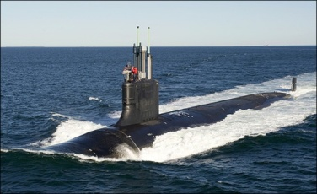

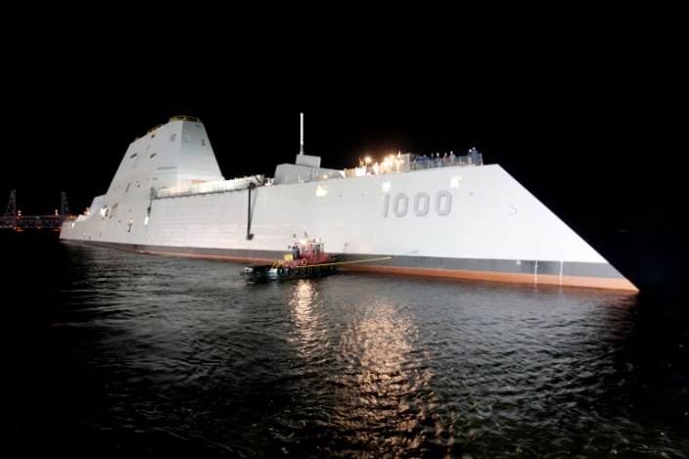
MPES At-A-Glance
Our Mission: Provide safe, reliable, innovative military power solutions to defend our nation and allies, and to support critical industrial infrastructure
Our Vision: To be the preferred supplier for mission critical electrical power solutions
We Provide: Major U.S. Navy shipbuilding programs with high-power quality, reliable, shock-hardened, EMI-compliant, electrical power distribution, conversion, protection and control systems
Our Markets and Customers are:
U.S. Navy, International Navies, and industrial applications
We Distinguish Ourselves by: Superior product quality and processes; Combat worthy products; 40 – 50 year life cycle; Full service and support

Slide 5

MPES Site Locations Anaheim, CA; Gardena, CA; Tulsa, OK; Philadelphia, PA

Slide 6





Maritime Power & Energy Solutions (MPES) Division
MPES-Anaheim
Power Conversion Modules, Frequency Converters, Advanced Degaussing Systems, Automatic Bus Transfer, Fault Isolation Unit, Medium Voltage Motor Drive
Tulsa
Anaheim
Philadelphia
MPES-Philadelphia
Power Node Control Centers, Switchboards, Circuit Breakers, Power Converters, Motor Controllers, Bus Transfer & Isolation Relay
MPES-Tulsa
Switchboards, Load Centers, Power & Lighting Panels, Arc Fault Detection

Slide 7




MPES Sites Anaheim, Philadelphia, and Tulsa
Manufacturing & Engineering Capabilities
Electrical Power Conversion and Distribution Equipment for Shipboard applications
AC/DC Converters of all types –10 kW up to 6MW
Circuit Breakers
Switchboards and Load Centers
400 Hz supplies for weapons systems
Aircraft starting systems
Arc Fault Detection Systems
Test Capabilities
EMI (MIL-STD-461 rated)
Airborne and Structureborne Noise
Thermal
Humidity
Vibration
Lightweight Shock

Slide 8





Engineering Opportunities
ELECTRICAL/POWER
MECHANICAL/THERMAL
SOFTWARE/CONTROLS
DIGITAL/ANALOG/PCB
SYSTEMS

Slide 9
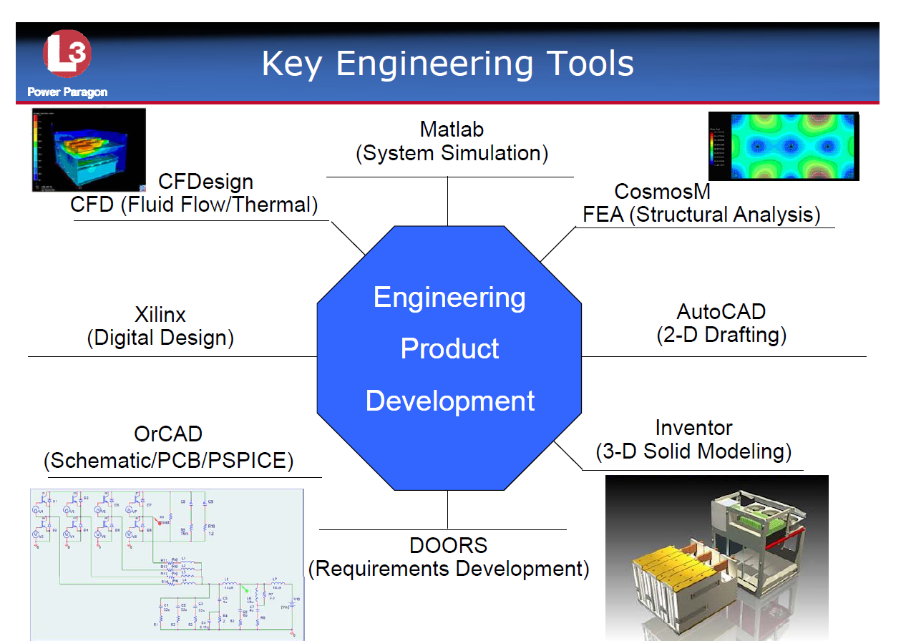
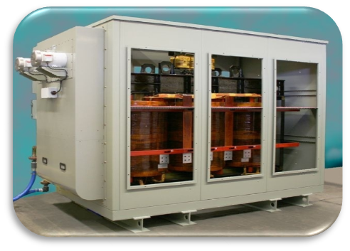
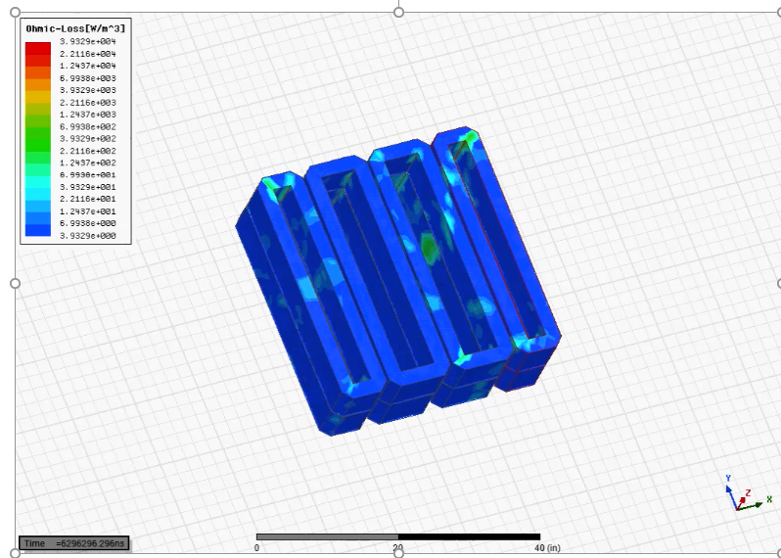
Engineering Opportunities
Key Tasks In Engineering
State of the Art Power Conversion, Conditioning, and Control
Power topology design/selection
High-power quality, bi-directional power conversion
Circuit analysis and advanced control algorithm modeling and simulation
Electromagnetic field modeling and simulation
Optimize components layout for electromagnetic compatibility (EMC)
Design development, integration, verification, and qualification

Slide 10
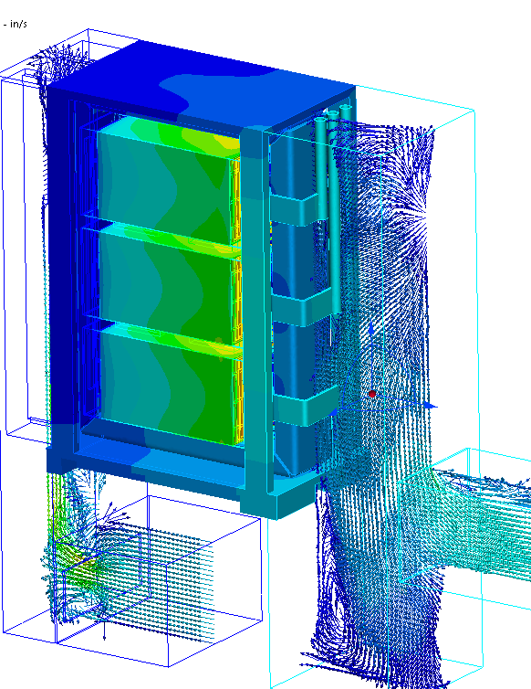
Engineering Opportunities
Key Tasks In Engineering (cont’d)
Advanced Mechanical Design, Packaging, and Analysis
FEA structural analysis for high shock and vibration environments (incl. non-linear and dynamic analysis)
CFD airflow and thermal analysis, modeling, and simulation

Slide 11
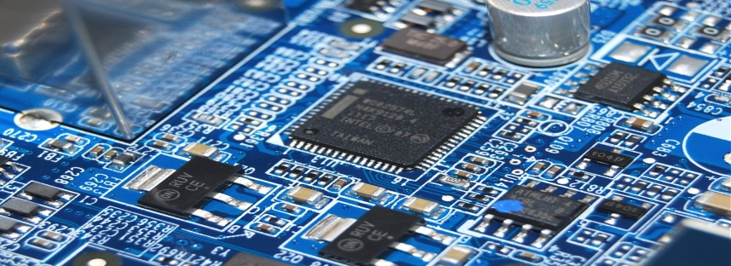

Engineering Opportunities
Key Tasks In Engineering (cont’d)
SW/FW Architecture Design, Development, and Integration
Embedded software for power conversion algorithms
High-level applications interfaced with embedded modules
Graphical User Interface (GUI) /Human-Machine-Interface (HMI) development and implementation
Digital logic design for FPGAs; VHDL coding and timing simulations
Digital signal processing algorithms for FPGAs and CPLDs

Slide 12
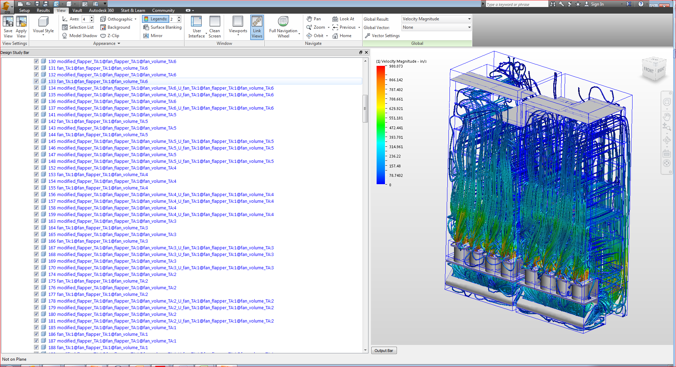
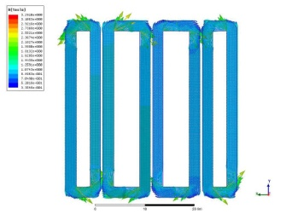
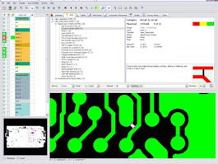
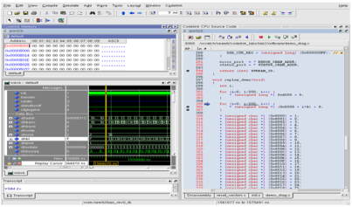
Engineering Analysis Tools
Design to Manufacture
Enhanced analysis tools to achieve design to manufacture in a short time
Mechanical Analysis Tools | Power, Elect, Digital, Controls Analysis Tools | PCB Design | Software Coding
3D Computer Aided Design (CAD) – Autodesk Inventor Structural / Dynamic Finite Elemental Analysis (FEA) –Ansys Mechanical Computational Fluid Dynamics (CFD) Analysis – Autodesk | ORCAD PSpice Circuit and Analysis – Cadence Matlab / Simulink Controls Analysis – Mathworks Maxwell 2D/3D Magnetic Flux Analysis – Ansys Simplorer Circuit Analysis - Ansys FPGA Firmware and VHDL Coding and Analysis – Questa SIM LabView rapid prototyping – National Instruments | Cadence Capture CIS / CIP Mentor Graphics Valor DfM / DfA PCB Library Expert Cadence Allegro | GSA Software WindRiver Rational Team Concert Code Warrior Visual Studio

Slide 13

Power Electronics Building Blocks
SOURCE
Components of Power Conversion Equipment
SOURCE
AC
DC
DC
AC
DC
DC
AC
AC
DC
DC
FILTERS
AC
AC
SENSORS/
CONTROLS/
HMI
LOGIC
POWER
SUPPLY
PROTECTIONS
(Fuses, Breakers, Arc Fault)
LOADS
LOADS
Establishing the basic components of Power Electronics and utilizing these as building blocks for Power Conversion to expedite maturity level

Slide 14
Power Electronics Building Blocks
Common building blocks for Power Conversion (AC/AC)
Prime Mover
440Vac/60 Hz, 3 Phase
Cooling
Fuses
Breakers
Transfer Switches
Full Bridge, Interleaved
Voltage/Current Control
Harmonic Elimination
Power Factor Correction
Cooling
Fuses
Full Bridge, Interleaved
Voltage/Current Control
Harmonic Elimination
Cooling
Fuses
Linear Load
Non-Linear Load
Motor Load
Fuses
Breakers
Cooling
AC Source
3 Phase
Loads
3 Phase
Filter
Active Rectifier
3 Phase
Filter
Inverter
3 Phase
Filter
Low Pass Passive Filter
Surge Protection
EMI Reduction
Cooling
Low Pass Passive Filter
Bulk Capacitance
Cooling
Low Pass Passive Filter
Surge Protection
EMI Reduction
Cooling
Establishing common power architectures to avoid reinventing the wheel

Slide 15
Power Electronics Building Blocks
Common building blocks for kW Power Conversion (DC/DC)
DC Source
Fuses
Breakers
Transfer Switches
Cooling
Full Bridge, Interleaved
Voltage/Current Control
Cooling
Fuses
Motor
Fuses
Breakers
Cooling
Full Bridge, Interleaved
Voltage/Current Control
Cooling
Fuses
DC Source
Loads
Filter
DC/DC
Converter
Isolation Stage
DC/DC Converter
Filter
Low Pass Passive Filter
Surge Protection
EMI Reduction
Cooling
Full Bridge
Galvanic Isolation
Cooling
Fuses
Low Pass Passive Filter
Surge Protection
EMI Reduction
Cooling
Establishing common power architectures to avoid reinventing the wheel

Slide 16
Requirements
Power Conversion Equipment Requirements to be Considered
Cost
Power density
Size and volume
Efficiency
Topology
Technology available
Ratings (voltage, current, and power)
Thermal management
Reliability
Manufacturability
Environmental robustness
Maintainability
Equipment support

Slide 17
Additional Requirements
Other parameters from component Suppliers to be considered
Time to Market
Multiple Suppliers or Sole Source for components
Component lead times
Annual product demand
ITAR requirements
US Citizenship requirements

Slide 18
Magnetics Requirements
Magnetics Applications at MPES
Transformers
Inductors
Needs from Magnetics Material
Low no-load losses
Extended overload capacity
Increased efficiency
Low environmental impact
Higher permeability
Consistency performance over temperature range
High saturation
Manufacturing flexibility
Low Magnetorestriction

Slide 19
Processes for Considerations
Design
Considerations
Core
Considerations
Coil
Considerations
Magnetics Build Considerations
Power rating
Voltage rating
AC current rating
DC current rating
Overload ratings
Inductance
Leakage inductance
Magnetizing inductance
Turns ratio
Gap
Core architecture
Shell type
Core type
Materials
Core type
Core material
Coil type
Insulation
Mechanical structure
Weight
Size
Copper loss
Core loss
Cooling
Dielectric withstand voltage
Core material
Core supplier
Annealing
Integrity of gap
Manufacturing process
Consistency
Quality
Cost
Lead time
ITAR restrictions
Coil supplier
Quality
Manufacturing process
Consistency
Quality
Cost
Lead time
ITAR restrictions
Manufacturer
Coil form
Core stack
Mechanical structure
Insulation
Varnish
Test
Manufacturing process
Consistency
Quality
Cost
Lead time
ITAR restrictions

Slide 20
Additional Factors to Consider
Unique aspects of nanocrystalline soft magnetics
Magnetorestriction force - Nanocrystalline has low magnetorestriction force than Metglas
Temperature dependency – Nanocrystalline has a higher temperature rating than Metglas
Overload capacity – Nanocrystalline has a lower overload capability than Metglas
Flux density – Nanocrystalline has a lower flux density than Metglas
Original Equipment Manufacturer (OEM) interests and needs
Networking through Distributors, Symposiums, and Conferences
Off-the-shelf solutions or custom design solution
Collaboration with OEMs from conceptual design to product delivery
User friendly website with product information, application notes, and simulation tools
Reachable and knowledgeable Technical Support Team
Lead time
Product reliability and consistent results
Ways to engage OEMs
Engage OEMs in a 1-hour Teams seminar to discuss unique products, innovative solutions, and 5-year term goal
Annual local conferences and symposiums

Slide 21
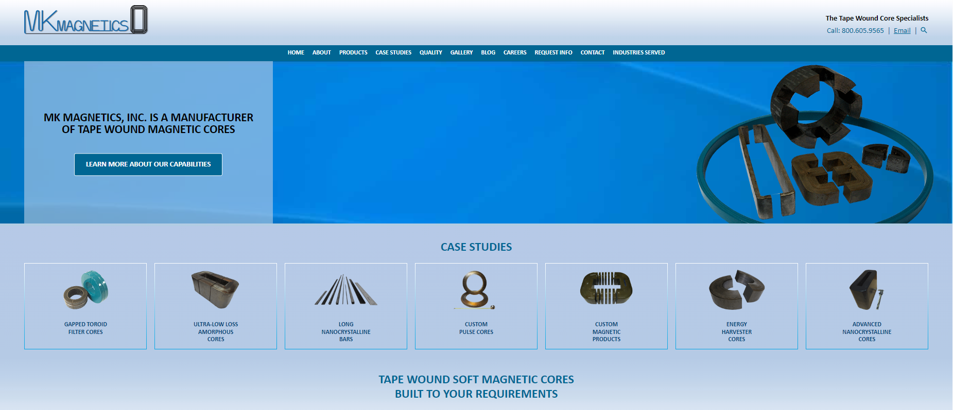
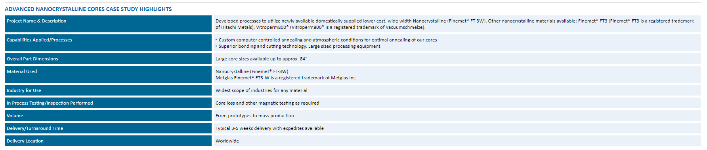
Magnetic Cores Suppliers
https://www.mkmagnetics.com/

Slide 22
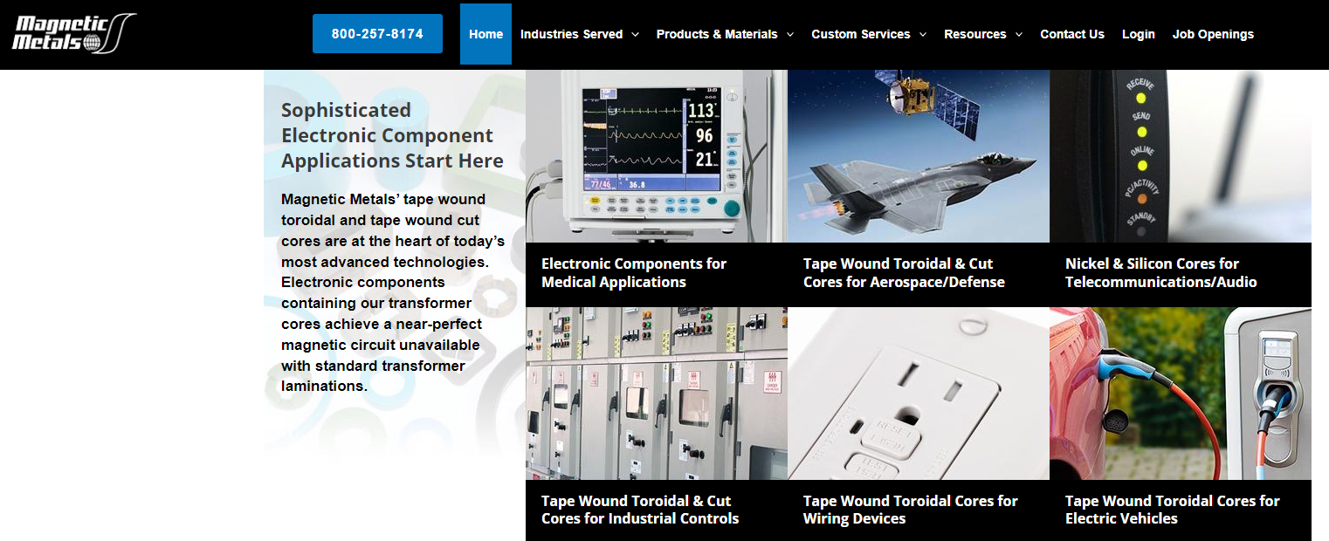
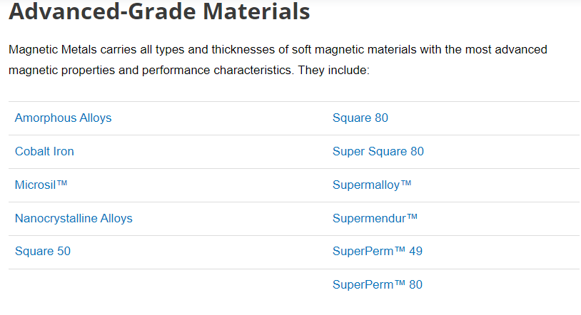
Magnetic Cores Suppliers
https://www.magneticmetals.com/

Slide 23

Magnetic Cores Suppliers
https://www.mag-inc.com/

Slide 24
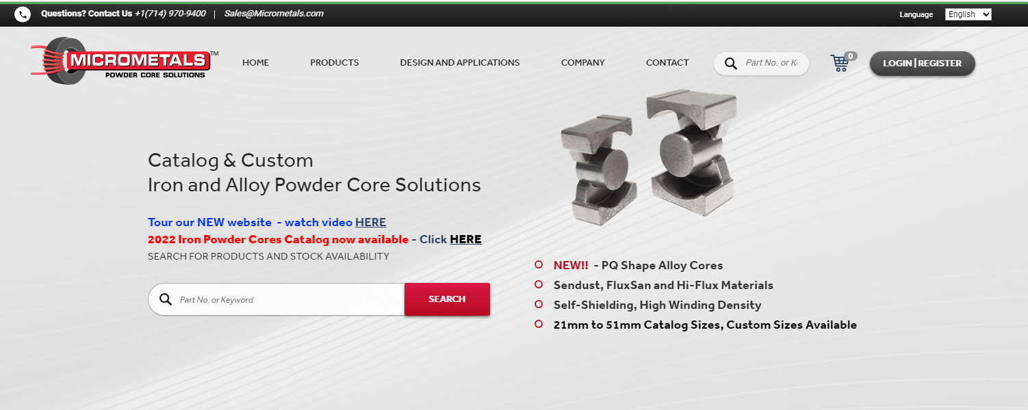
Magnetic Cores Suppliers
https://www.micrometals.com/

Slide 25
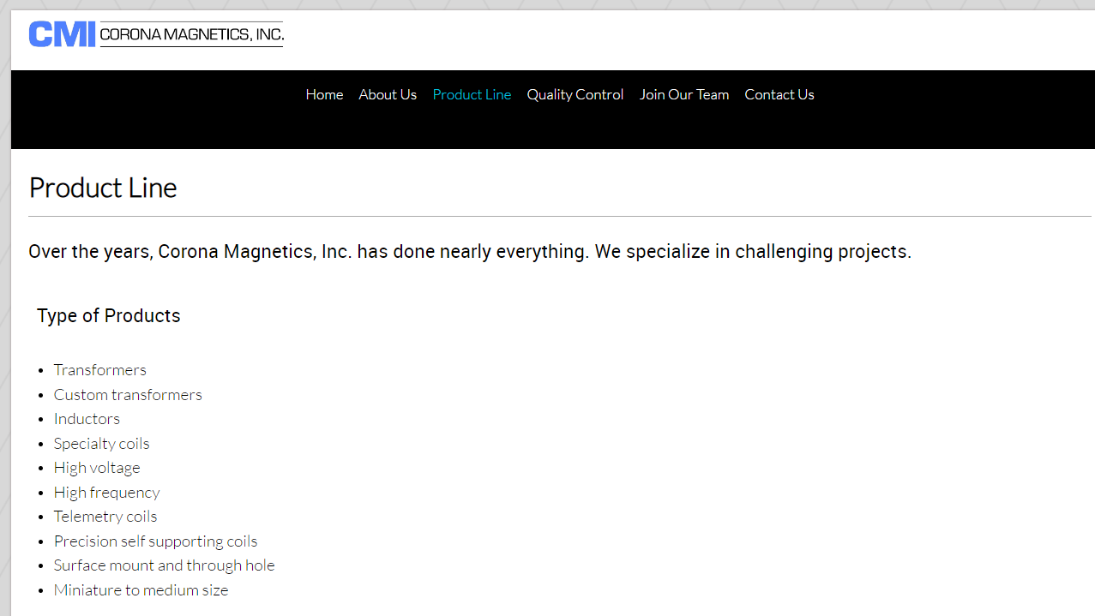
Transformers and Inductors Suppliers
http://www.corona-magnetics.com/

Slide 26
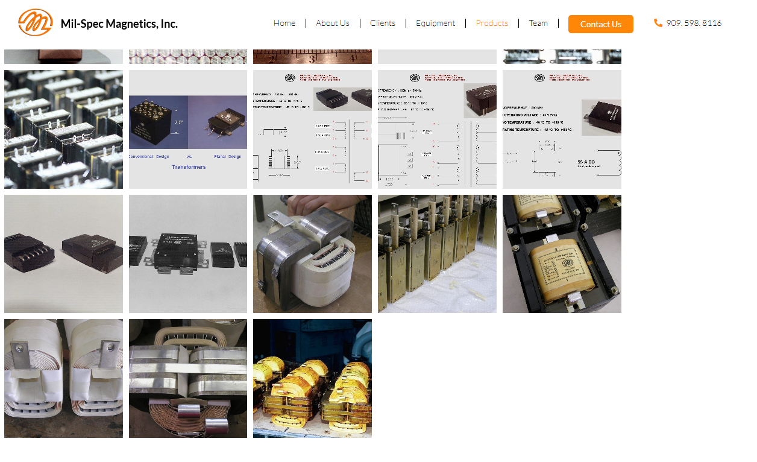
Transformers and Inductors Suppliers
https://milspecmag.com/

Slide 27

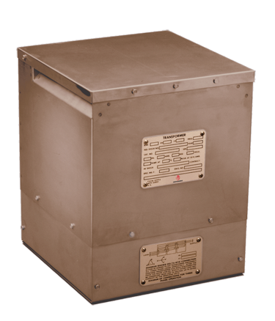
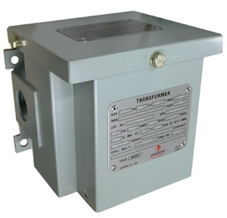
Transformers and Inductors Suppliers
https://www.l3harris.com/

Slide 28
Questions
Questions

